Slide 1
DoS and DDoS attack demonstration in class using a Simulation Software.
Qiuyi Chen
18467538

Slide 2
Software Defined Networking (SDN) is a new networking paradigm where forwarding hardware is decoupled from control decisions. It promises to dramatically simplify network management and enable innovation and evolution.

Slide 3
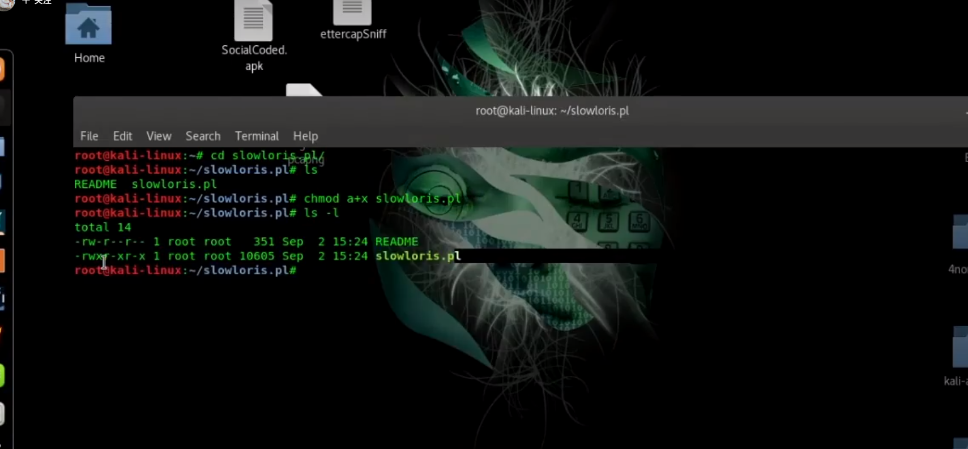
Try to attack the website and make it inoperable

Slide 4
